Slide 1

CHAPTER 2 – Epp, 4th Ed
Epp, Susanna S., Discrete Mathematics with Applications, Fourth Edition
Binary Number Systems
This section is optional in CMSC203. It is intended to help students be prepared for the UMCP Exemption Exam
Copyright © Cengage Learning. All rights reserved.

Slide 2
SECTION 2.5
Application: Number Systems and Circuits for Addition
Copyright © Cengage Learning. All rights reserved.

Slide 3
Application: Number Systems and Circuits for Addition
In elementary school, you learned the meaning of decimal notation: that to interpret a string of decimal digits as a number, you mentally multiply each digit by its place value.
For instance, 5,049 has a 5 in the thousands place, a 0 in the hundreds place, a 4 in the tens place, and a 9 in the ones place. Thus
5,049 = 5  (1,000) + 0  (100) + 4  (10) + 9  (1).

Slide 4
Application: Number Systems and Circuits for Addition
Using exponential notation, this equation can be rewritten as
5,049 = 5  10³ + 0  10² + 4  10¹ + 9  10⁰.
More generally, decimal notation is based on the fact that any positive integer can be written uniquely as a sum of products of the form
d  10^{n},
where each n is a nonnegative integer and each d is one of the decimal digits 0, 1, 2, 3, 4, 5, 6, 7, 8, or 9.

Slide 5
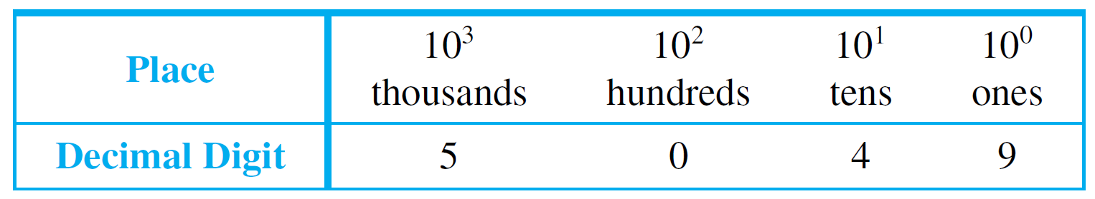
Application: Number Systems and Circuits for Addition
The word decimal comes from the Latin root deci, meaning “ten.” Decimal (or base 10) notation expresses a number as a string of digits in which each digit’s position indicates the power of 10 by which it is multiplied.
The right-most position is the ones place (or 10⁰ place), to the left of that is the tens place (or 10¹ place), to the left of that is the hundreds place (or 10² place), and so forth, as illustrated below.

Slide 6
Binary Representation of Numbers

Slide 7
Binary Representation of Numbers
In computer science, base 2 notation, or binary notation, is of special importance because the signals used in modern electronics are always in one of only two states. (The Latin root bi means “two.”)
We can show that any integer can be represented uniquely as a sum of products of the form
d  2^{n},
where each n is an integer and each d is one of the binary digits (or bits) 0 or 1.

Slide 8
Binary Representation of Numbers
For example,
27 = 16 + 8 + 2 + 1
= 1  2⁴ + 1  2³ + 0  2² + 1  2¹ + 1  2⁰.
The places in binary notation correspond to the various powers of 2.

Slide 9
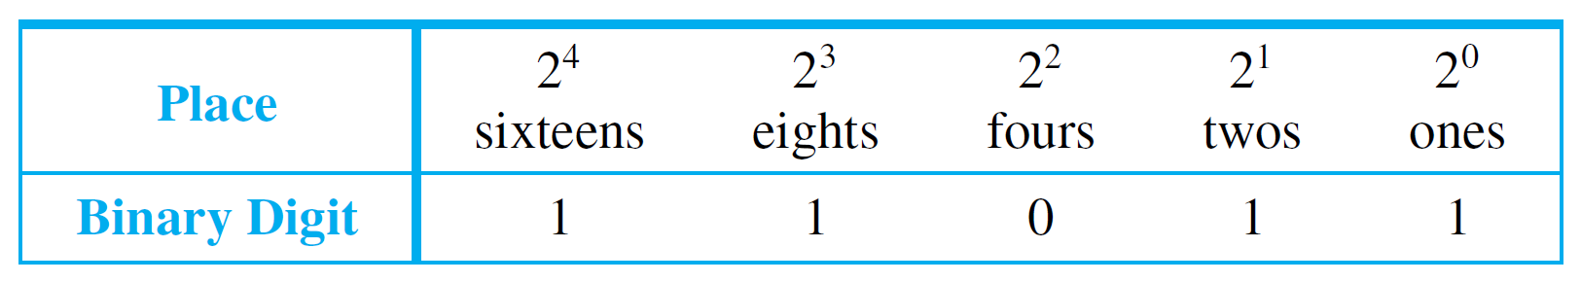
Binary Representation of Numbers
The right-most position is the ones place (or 2⁰ place), to the left of that is the twos place (or 2¹ place), to the left of that is the fours place (or 2² place), and so forth, as illustrated below.
As in the decimal notation, leading zeros may be added or dropped as desired. For example,

Slide 10
Binary Representation of Numbers
A list of powers of 2 is useful for doing binary-to-decimal and decimal-to-binary conversions. See Table 2.5.1.
Powers of 2
Table 2.5.1

Slide 11


Example 2 – Converting a Binary to a Decimal Number
Represent 110101₂ in decimal notation.
Solution:

Slide 12
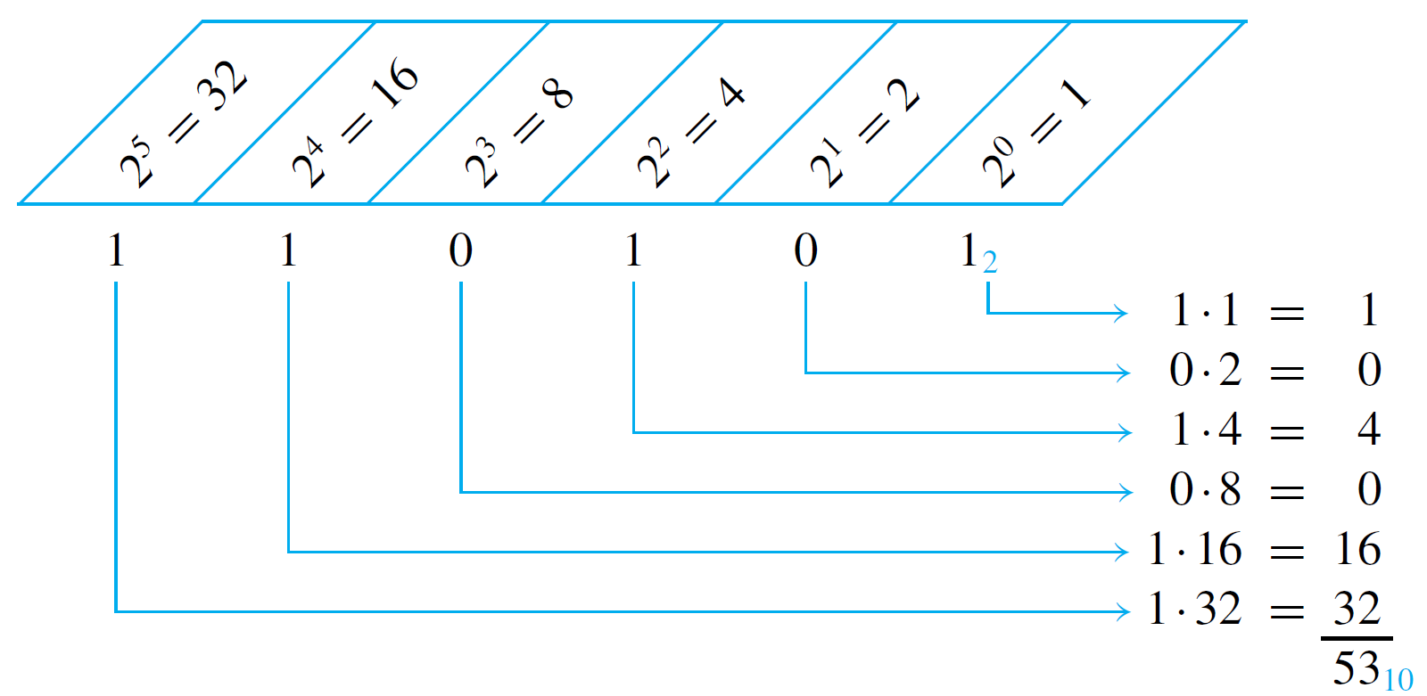
Example 2 – Solution
cont’d
Alternatively, the schema below may be used.

Slide 13
Example 3 – Converting a Decimal to a Binary Number
Represent 209 in binary notation.
Solution:
Use Table 2.5.1 to write 209 as a sum of powers of 2, starting with the highest power of 2 that is less than 209 and continuing to lower powers.
Powers of 2
Table 2.5.1

Slide 14
Example 3 – Solution
cont’d
Since 209 is between 128 and 256, the highest power of 2 that is less than 209 is 128. Hence
209₁₀ = 128 + a smaller number.
Now 209 − 128 = 81, and 81 is between 64 and 128, so the highest power of 2 that is less than 81 is 64. Hence
209₁₀ = 128 + 64 + a smaller number.

Slide 15

Example 3 – Solution
cont’d
Continuing in this way, you obtain
For each power of 2 that occurs in the sum, there is a 1 in the corresponding position of the binary number.

Slide 16

Example 3 – Solution
cont’d
For each power of 2 that is missing from the sum, there is a 0 in the corresponding position of the binary number.
Thus

Slide 17
Binary Addition and Subtraction

Slide 18
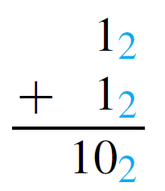
Example 4 – Addition in Binary Notation
Add 1101₂ and 111₂ using binary notation.
Solution:
Because 2₁₀ = 10₂ and 1₁₀ = 1₂, the translation of 1₁₀ + 1₁₀ = 2₁₀ to binary notation is
It follows that adding two 1’s together results in a carry of 1 when binary notation is used.

Slide 19
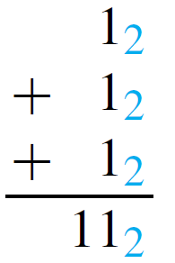
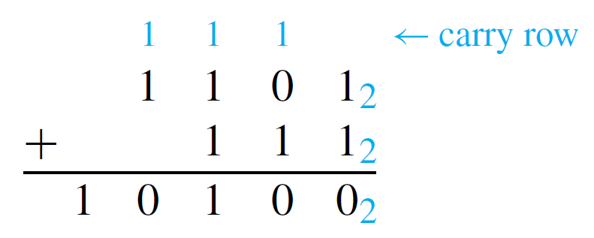
Example 4 – Solution
cont’d
Adding three 1’s together also results in a carry of 1 since 3₁₀ = 11₂ (“one one base two”).
Thus the addition can be performed as follows:

Slide 20
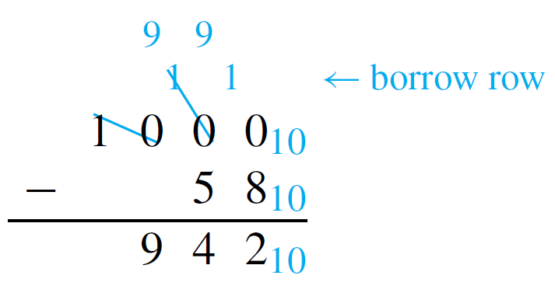
Example 5 – Subtraction in Binary Notation
Subtract 1011₂ from 11000₂ using binary notation.
Solution:
In decimal subtraction the fact that 10₁₀ − 1₁₀ = 9₁₀ is used to borrow across several columns. For example, consider the following:

Slide 21
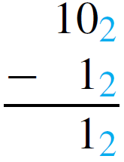
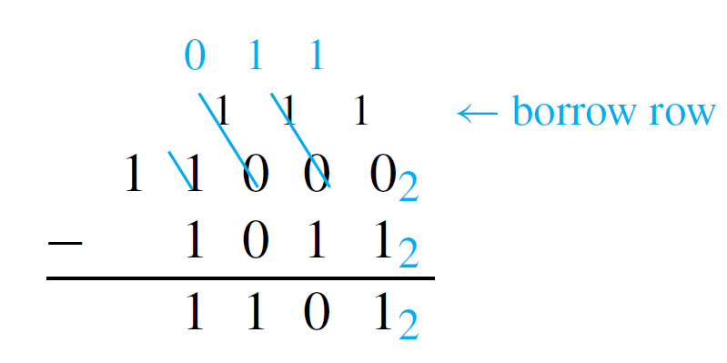
Example 5 – Solution
cont’d
In binary subtraction it may also be necessary to borrow across more than one column. But when you borrow a 1₂ from 10₂, what remains is 1₂.
Thus the subtraction can be performed as follows:

Slide 22
Circuits for Computer Addition

Slide 23
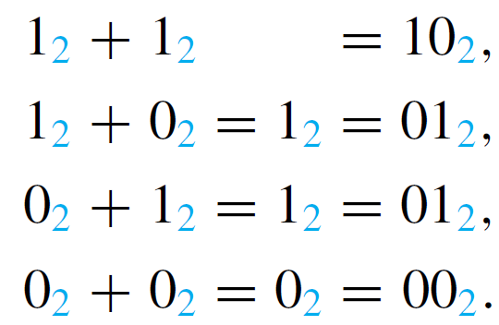
Circuits for Computer Addition
Consider the question of designing a circuit to produce the sum of two binary digits P and Q. Both P and Q can be either 0 or 1. And the following facts are known:

Slide 24
Circuits for Computer Addition
It follows that the circuit to be designed must have two outputs—one for the left binary digit (this is called the carry) and one for the right binary digit (this is called the sum).
The carry output is 1 if both P and Q are 1; it is 0 otherwise. Thus the carry can be produced using the AND-gate circuit that corresponds to the Boolean expression P ∧ Q. The sum output is 1 if either P or Q, but not both, is 1.

Slide 25
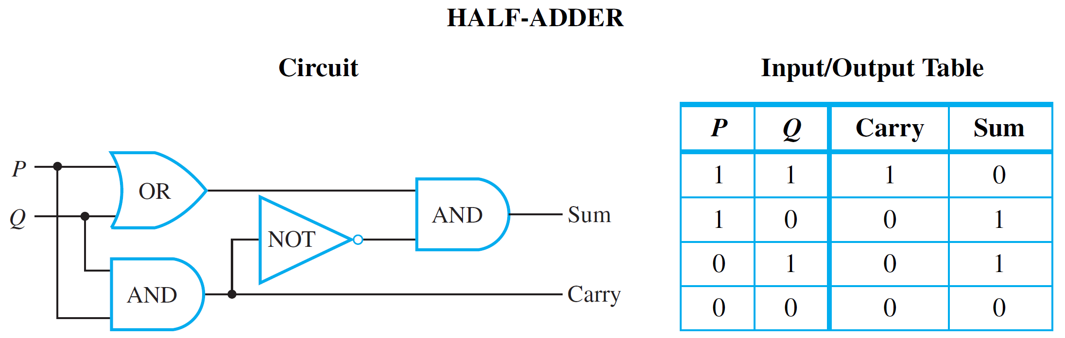
Circuits for Computer Addition
The sum can, therefore, be produced using a circuit that corresponds to the Boolean expression for exclusive or : (P ∨ Q) ∧ ∼ (P ∧ Q). Hence, a circuit to add two binary digits P and Q can be constructed as in Figure 2.5.1. This circuit is called a half-adder.
Circuit to Add P + Q, Where P and Q Are Binary Digits
Figure 2.5.1

Slide 26
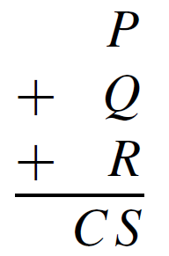
Circuits for Computer Addition
In order to construct a circuit that will add multidigit binary numbers, it is necessary to incorporate a circuit that will compute the sum of three binary digits. Such a circuit is called a full-adder.
Consider a general addition of three binary digits P, Q, and R that results in a carry (or left-most digit) C and a sum (or right-most digit) S.

Slide 27
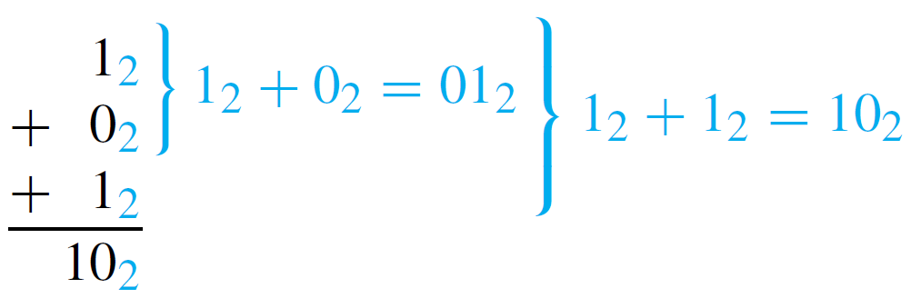
Circuits for Computer Addition
The operation of the full-adder is based on the fact that addition is a binary operation: Only two numbers can be added at one time. Thus P is first added to Q and then the result is added to R. For instance, consider the following addition:

Slide 28
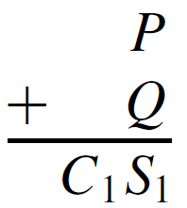
Circuits for Computer Addition
The process illustrated here can be broken down into steps that use half-adder circuits.
Step 1: Add P and Q using a half-adder to obtain a binary number with two digits.

Slide 29
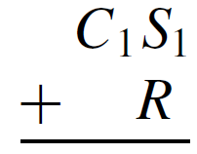
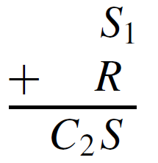
Circuits for Computer Addition
Step 2: Add R to the sum C₁S₁ of P and Q.
To do this, proceed as follows:
Step 2a: Add R to S₁ using a half-adder to obtain the two-digit number C₂S.
Then S is the right-most digit of the entire sum of P, Q, and R.

Slide 30
Circuits for Computer Addition
Step 2b: Determine the left-most digit, C, of the entire sum as follows: First note that it is impossible for both C₁ and C₂ to be 1’s. For if C₁ = 1, then P and Q are both 1, and so S₁ = 0. Consequently, the addition of S₁ and R gives a binary number C₂S₁ where C₂ = 0.
Next observe that C will be a 1 in the case that the addition of P and Q gives a carry of 1 or in the case that the addition of S₁ (the right-most digit of P + Q) and R gives a carry of 1.

Slide 31
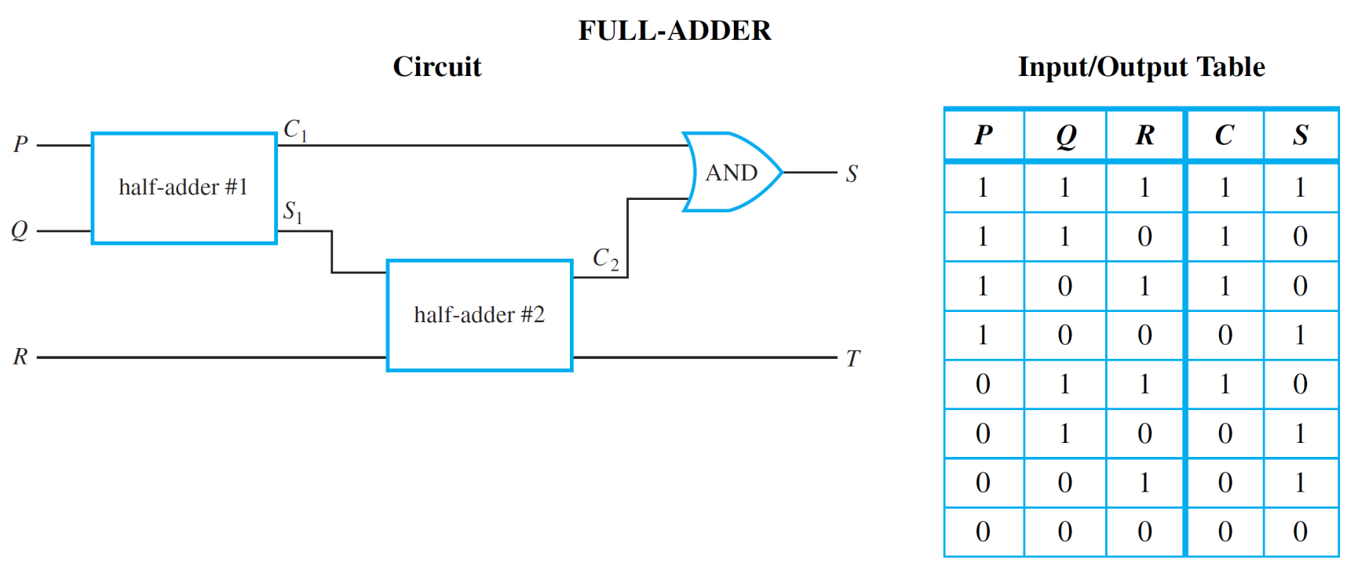
Circuits for Computer Addition
In other words, C = 1 if, and only if, C₁ = 1 or C₂ = 1. It follows that the circuit shown in Figure 2.5.2 will compute the sum of three binary digits.
Circuit to Add P + Q + R, Where P, Q, and R Are Binary Digits
Figure 2.5.2

Slide 32
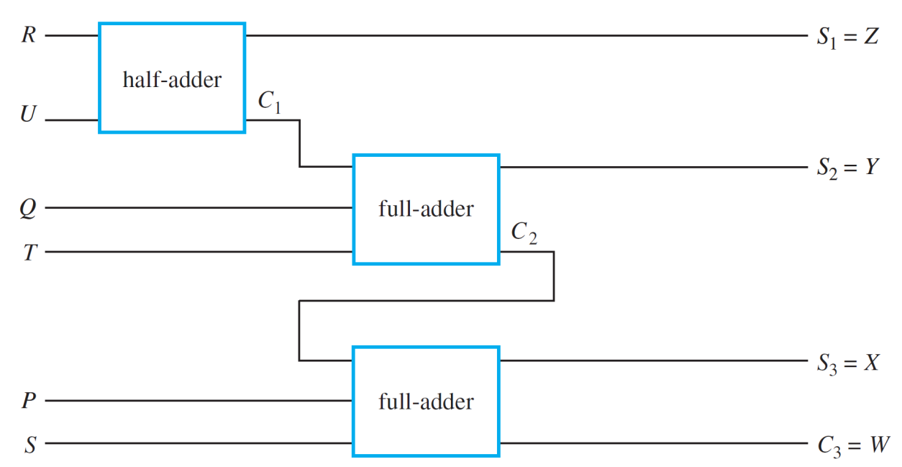
Circuits for Computer Addition
Two full-adders and one half-adder can be used together to build a circuit that will add two three-digit binary numbers PQR and STU to obtain the sum WXYZ. This is illustrated in Figure 2.5.3. Such a circuit is called a parallel adder.
Parallel adders can be constructed to add binary numbers of any finite length.
A Parallel Adder to Add PQR and STU to Obtain WXYZ
Figure 2.5.3

Slide 33
Two’s Complements and the Computer Representation of Negative Integers

Slide 34
Two’s Complements and the Computer Representation of Negative Integers
Typically, a fixed number of bits is used to represent integers on a computer, and these are required to represent negative as well as nonnegative integers.
Sometimes a particular bit, normally the left-most, is used as a sign indicator, and the remaining bits are taken to be the absolute value of the number in binary notation.
The problem with this approach is that the procedures for adding the resulting numbers are somewhat complicated and the representation of 0 is not unique.

Slide 35
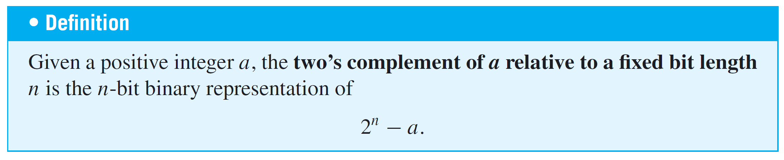
Two’s Complements and the Computer Representation of Negative Integers
A more common approach, using two’s complements, makes it possible to add integers quite easily and results in a unique representation for 0. The two’s complement of an integer relative to a fixed bit length is defined as follows:

Slide 36

Two’s Complements and the Computer Representation of Negative Integers
There is a convenient way to compute two’s complements that involves less arithmetic than direct application of the definition. For an 8-bit representation, it is based on three facts:
1.
2. The binary representation of
3. Subtracting an 8-bit binary number a from 11111111₂ just switches all the 0’s in a to 1’s and all the 1’s to 0’s. (The resulting number is called the one’s complement of the given number.)

Slide 37
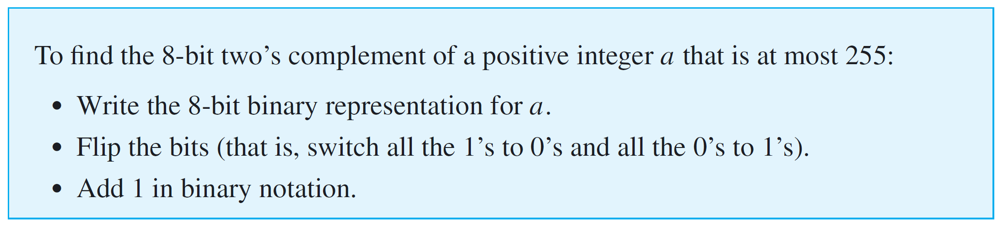
Two’s Complements and the Computer Representation of Negative Integers
In general,

Slide 38
Example 6 – Finding a Two’s Complement
Find the 8-bit two’s complement of 19.
Solution:
Write the 8-bit binary representation for 19, switch all the 0’s to 1’s and all the 1’s to 0’s, and add 1.

Slide 39



Example 6 – Solution
cont’d
To check this result, note that
which is the two’s complement of 19.

Slide 40

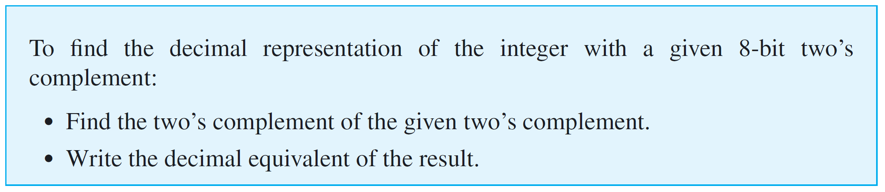
Two’s Complements and the Computer Representation of Negative Integers
Observe that because
the two’s complement of the two’s complement of a number is the number itself, and therefore,

Slide 41

Example 7 – Finding a Number with a Given Two’s Complement
What is the decimal representation for the integer with two’s complement 10101001?
Solution:

Slide 42



Example 7 – Solution
cont’d
To check this result, note that the given number is
which is the two’s complement of 87.

Slide 43
8-Bit Representation of a Number

Slide 44

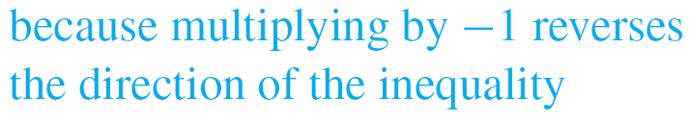

8-Bit Representation of a Number
Now consider the two’s complement of an integer n that satisfies the inequality 1 ≤ n ≤ 128. Then
and

Slide 45
8-Bit Representation of a Number
It follows that the 8-bit two’s complement of an integer from 1 through 128 has a leading bit of 1. Note also that the ordinary 8-bit representation of an integer from 0 through 127 has a leading bit of 0.
Consequently, eight bits can be used to represent both nonnegative and negative integers by representing each nonnegative integer up through 127 using ordinary 8-bit binary notation and representing each negative integer from −1 through −128 as the two’s complement of its absolute value.

Slide 46
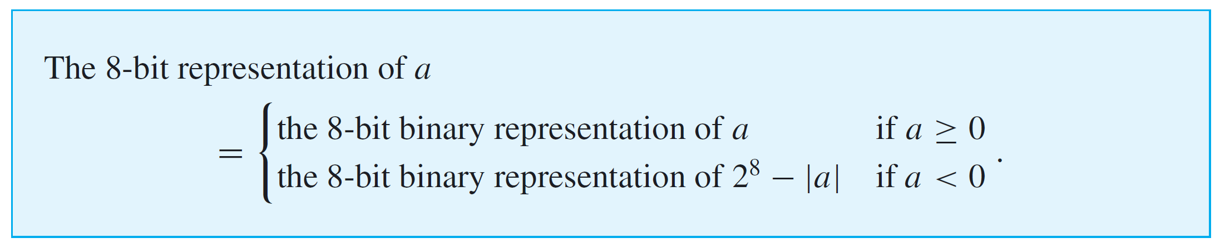
8-Bit Representation of a Number
That is, for any integer a from −128 through 127,

Slide 47
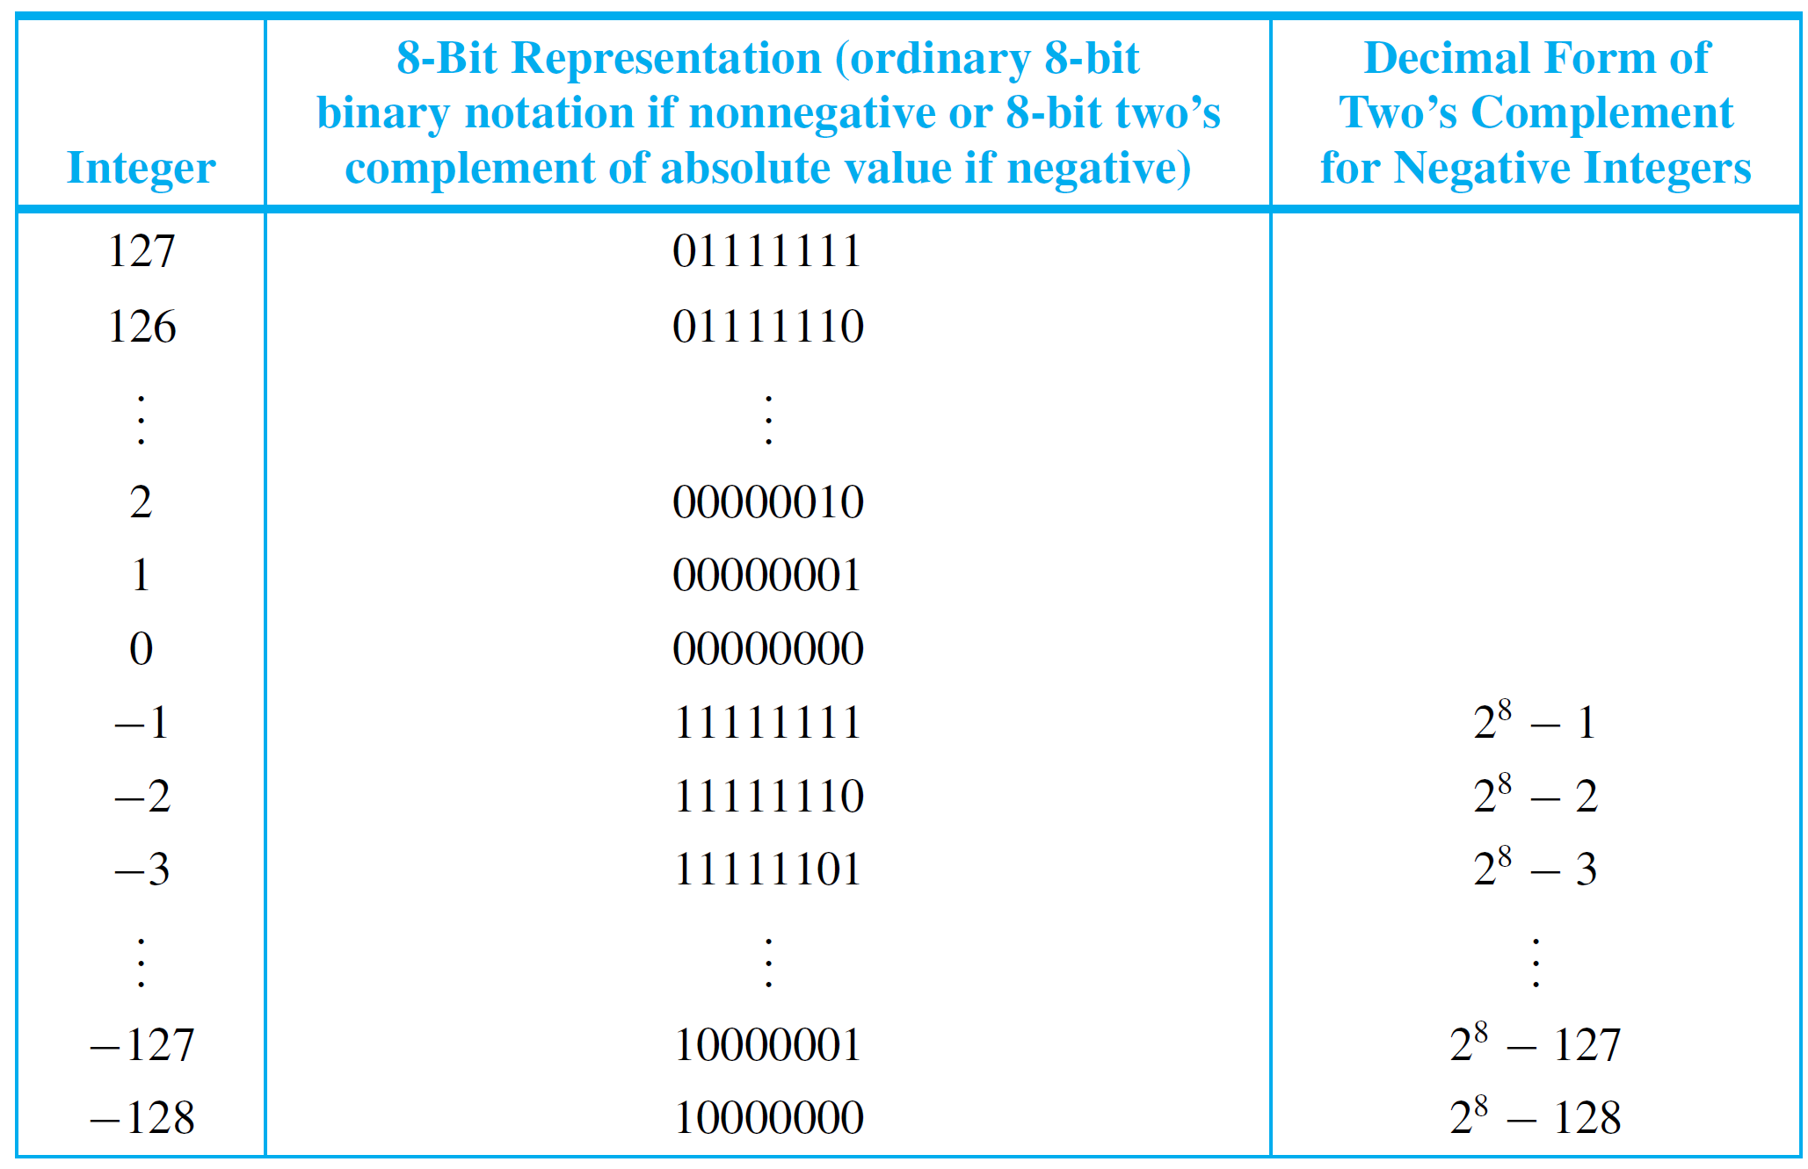
8-Bit Representation of a Number
The representations are illustrated in Table 2.5.2.
Table 2.5.2

Slide 48
Computer Addition with
Negative Integers

Slide 49
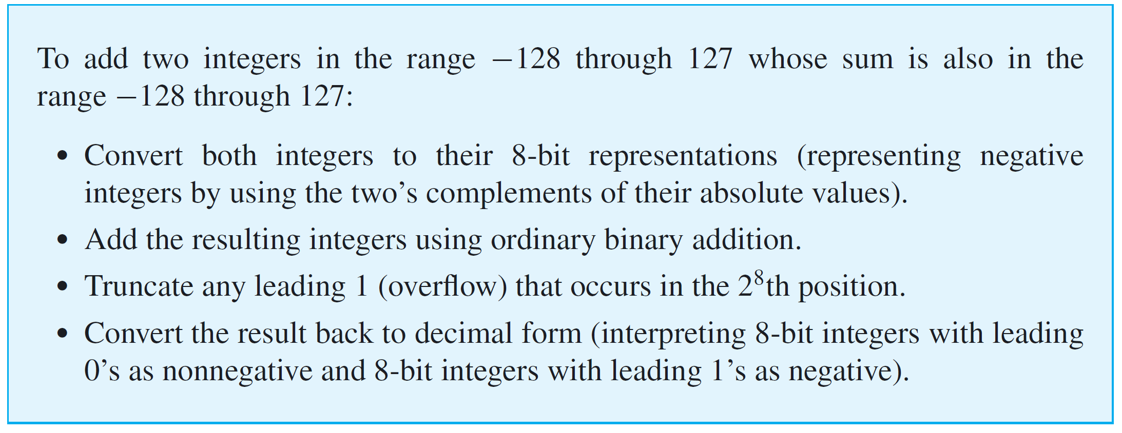
Computer Addition with Negative Integers

Slide 50
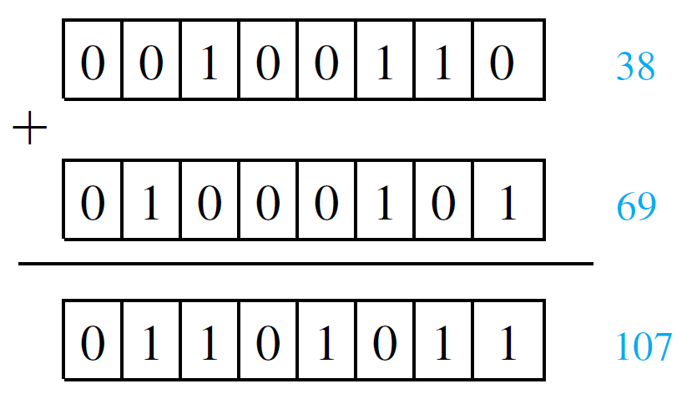
Computer Addition with Negative Integers
Case 1, (both integers are nonnegative): This case is easy because if two nonnegative integers from 0 through 127 are written in their 8-bit representations and if their sum is also in the range 0 through 127, then the 8-bit representation of their sum has a leading 0 and is therefore interpreted correctly as a nonnegative integer.
The example below illustrates what happens when 38 and 69 are added.

Slide 51

Computer Addition with Negative Integers
To be concrete, let the nonnegative integer be a and the negative integer be −b and suppose both a and −b are in the range −128 through 127. The crucial observation is that adding the 8-bit representations of a and −b is equivalent to computing
because the 8-bit representation of −b is the binary representation of 2⁸ − b.

Slide 52

Computer Addition with Negative Integers
Case 2 (a is nonnegative and −b is negative and |a| < |b|): In this case, observe that a = |a| < |b| = b and
and the binary representation of this number is the 8-bit representation of −(b − a) = a + (−b). We must be careful to check that 2⁸ − (b − a) is between 2⁷ and 2⁸. But it is because
Hence in case |a| < |b|, adding the 8-bit representations of a and −b gives the 8-bit representation of a + (−b).

Slide 53
Example 8 – Computing a + (−b) Where 0 ≤ a < b ≤ 128
Use 8-bit representations to compute 39 + (−89).
Solution:
Step 1: Change from decimal to 8-bit representations using the two’s complement to represent −89.
Since 39₁₀ = (32 + 4 + 2 + 1)₁₀ = 100111₂, the 8-bit representation of 39 is 00100111.
Now the 8-bit representation of −89 is the two’s complement of 89.

Slide 54
Example 8 – Solution
cont’d
This is obtained as follows:
So the 8-bit representation of −89 is 10100111.

Slide 55
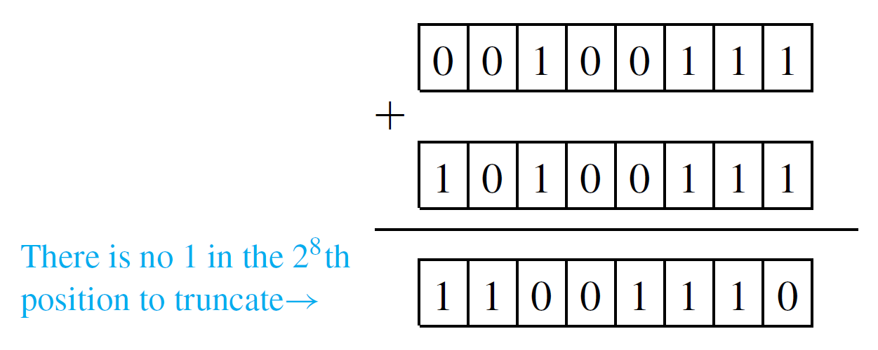
Example 8 – Solution
cont’d
Step 2: Add the 8-bit representations in binary notation and truncate the 1 in the 2⁸th position if there is one:

Slide 56
Example 8 – Solution
cont’d
Step 3: Find the decimal equivalent of the result. Since its leading bit is 1, this number is the 8-bit representation of a negative integer.
Note that since 39 − 89 = −50, this procedure gives the correct answer.

Slide 57

Computer Addition with Negative Integers
Case 3 (a is nonnegative and −b is negative and |b| ≤ |a|): In this case, observe that b = |b| ≤ |a| = a and
Also
So the binary representation of has a leading 1 in the ninth (2⁸th) position. This leading 1 is often called “overflow” because it does not fit in the 8-bit integer format.

Slide 58
Computer Addition with Negative Integers
Now subtracting 2⁸ from 2⁸ + (a − b) is equivalent to truncating the leading 1 in the 2⁸th position of the binary representation of the number. But
Hence in case |a| ≥ |b|, adding the 8-bit representations of a and −b and truncating the leading 1 (which is sure to be present) gives the 8-bit representation of a + (−b).

Slide 59
Example 9 – Computing a + (−b) Where 1 ≤ b < a ≤ 127
Use 8-bit representations to compute 39 + (−25).
Solution:
Step 1: Change from decimal to 8-bit representations using the two’s complement to represent −25.
As in Example 8, the 8-bit representation of 39 is 00100111. Now the 8-bit representation of −25 is the two’s complement of 25, which is obtained as follows:

Slide 60
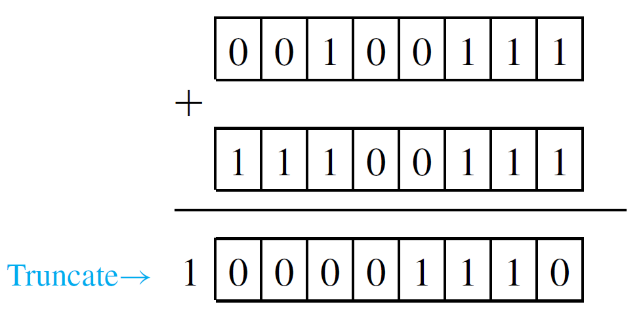
Example 9 – Solution
cont’d
So the 8-bit representation of −25 obtained as 11100111.
Step 2: Add the 8-bit representations in binary notation and truncate the 1 in the 2⁸th position if there is one:

Slide 61


Example 9 – Solution
cont’d
Step 3: Find the decimal equivalent of the result:
Since 39 − 25 = 14, this is the correct answer.

Slide 62
Computer Addition with Negative Integers
Case 4 (both integers are negative): This case involves adding two negative integers in the range −1 through −128 whose sum is also in this range.
To be specific, consider the sum (−a) + (−b) where a, b, and a + b are all in the range 1 through 128. In this case, the 8-bit representations of −a and −b are the 8-bit representations of 2⁸ − a and 2⁸ − b.
So if the 8-bit representations of −a and −b are added, the result is

Slide 63
Computer Addition with Negative Integers
We know that truncating a leading 1 in the ninth (2⁸th) position of a binary number is equivalent to subtracting 2⁸.
So when the leading 1 is truncated from the 8-bit representation of (2⁸ − a) + (2⁸ − b), the result is 2⁸ − (a + b), which is the 8-bit representation of −(a + b) = (−a) + (−b).

Slide 64
Example 10 – Computing (−a) + (−b) Where 1 ≤ a, b ≤ 128, and 1 ≤ a + b ≤ 128
Use 8-bit representations to compute (−89) + (−25).
Solution:
Step 1: Change from decimal to 8-bit representations using the two’s complements to represent −89 and −25.
The 8-bit representations of −89 and −25 were shown in Examples 2.5.8 and 2.5.9 to be 10100111 and 11100111, respectively.

Slide 65
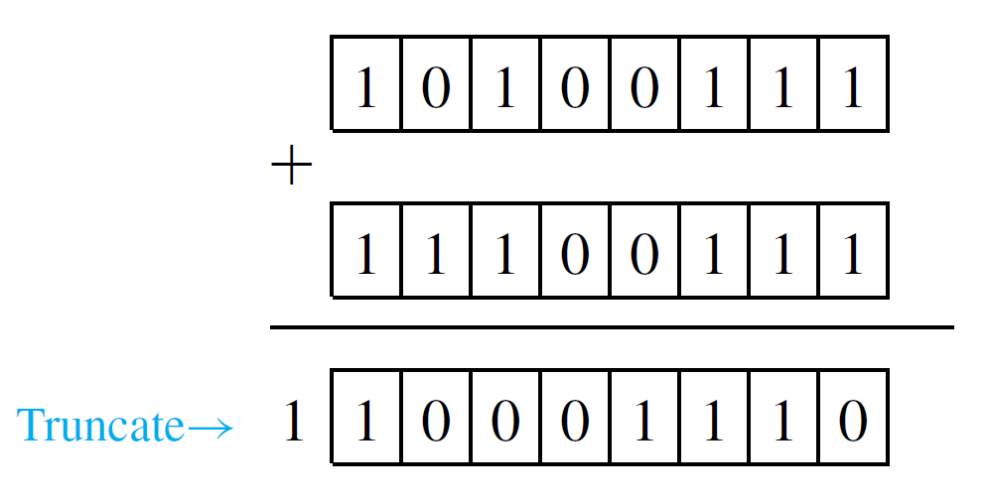
Example 10 – Solution
cont’d
Step 2: Add the 8-bit representations in binary notation and truncate the 1 in the 2⁸th position if there is one:

Slide 66
Example 10 – Solution
cont’d
Step 3: Find the decimal equivalent of the result. Because its leading bit is 1, this number is the 8-bit representation of a negative integer.
Since (−89) + (−25) = −114, that is the correct answer.

Slide 67
Hexadecimal Notation

Slide 68
Hexadecimal Notation
Hexadecimal notation is even more compact than decimal notation, and it is much easier to convert back and forth between hexadecimal and binary notation than it is between binary and decimal notation.
The word hexadecimal comes from the Greek root hex-, meaning “six,” and the Latin root deci-, meaning “ten.” Hence hexadecimal refers to “sixteen,” and hexadecimal notation is also called base 16 notation.

Slide 69

Hexadecimal Notation
Hexadecimal notation is based on the fact that any integer can be uniquely expressed as a sum of numbers of the form
where each n is a nonnegative integer and each d is one of the integers from 0 to 15. In order to avoid ambiguity, each hexadecimal digit must be represented by a single symbol. The integers 10 through 15 are represented by the symbols A, B, C, D, E, and F.

Slide 70
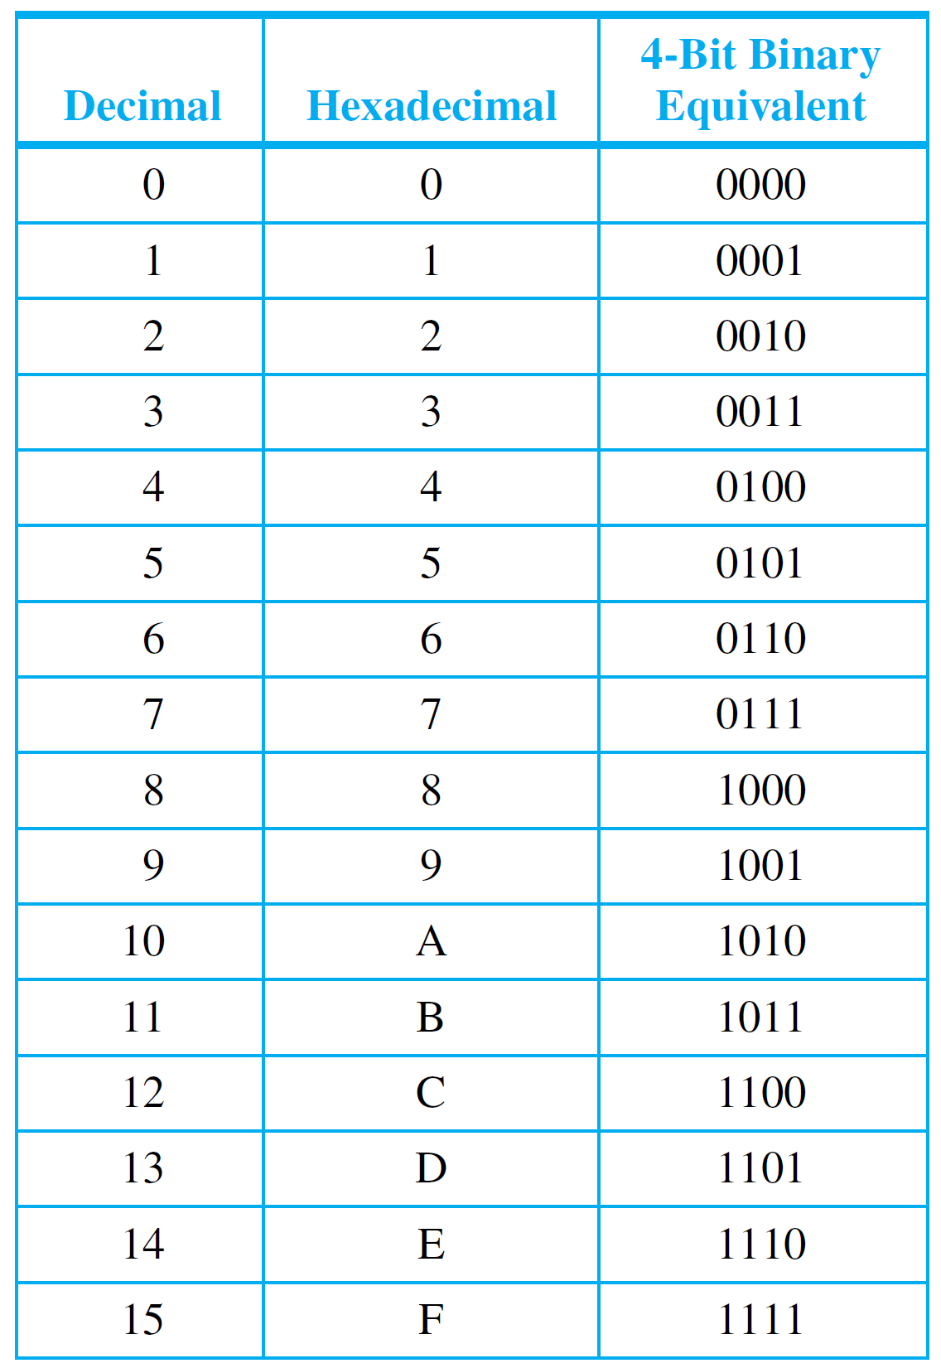
Hexadecimal Notation
The sixteen hexadecimal digits are shown in Table 2.5.3, together with their decimal equivalents and, for future reference, their 4-bit binary equivalents.
Table 2.5.3

Slide 71
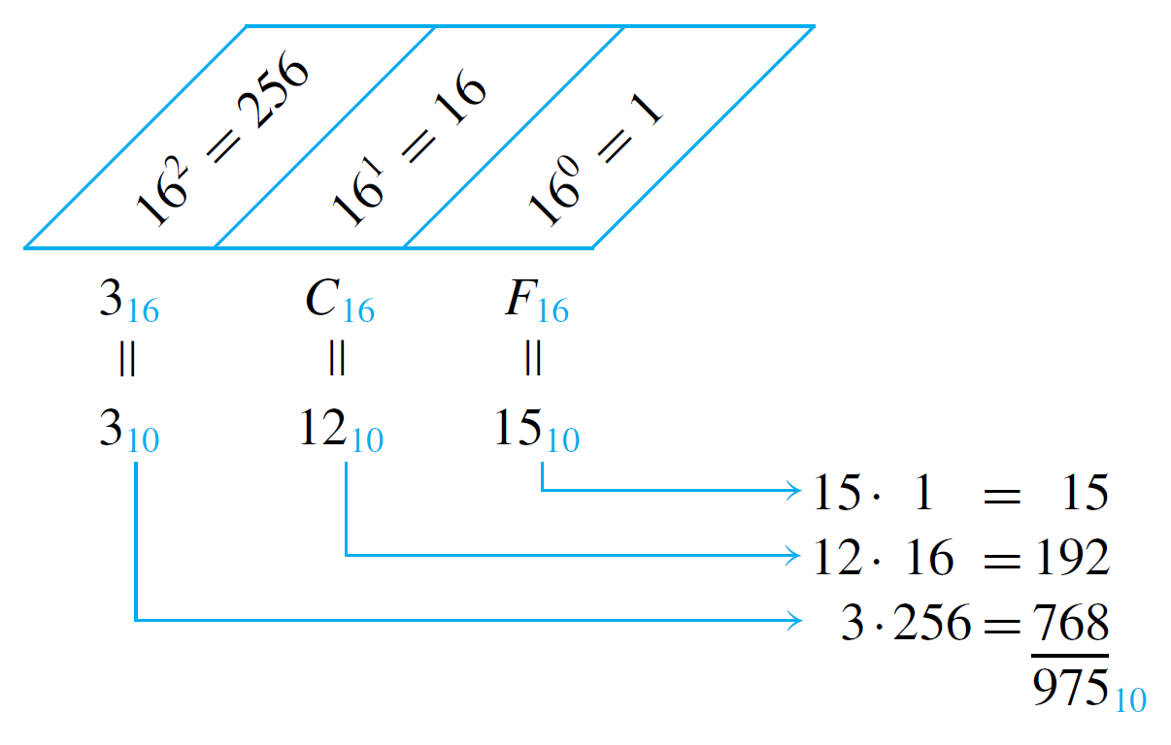
Example 11 – Converting from Hexadecimal to Decimal Notation
Convert 3CF₁₆ to decimal notation.
Solution:
Consider the following schema.
So 3CF₁₆ = 975₁₀.

Slide 72
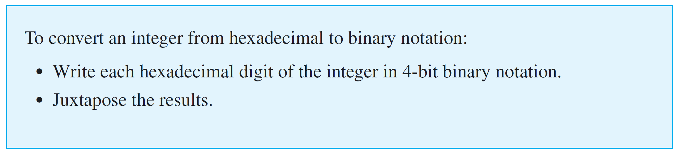
Hexadecimal Notation
Now consider how to convert from hexadecimal to binary notation.
The following sequence of steps will give the required conversion from hexadecimal to binary notation.

Slide 73





Example 12 – Converting from Hexadecimal to Binary Notation
Convert B09F₁₆ to binary notation.
Solution:
and

Slide 74
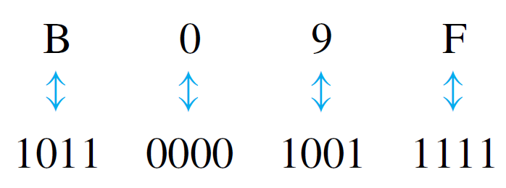
Example 12 – Solution
cont’d
Consequently,
and the answer is 1011000010011111₂.

Slide 75
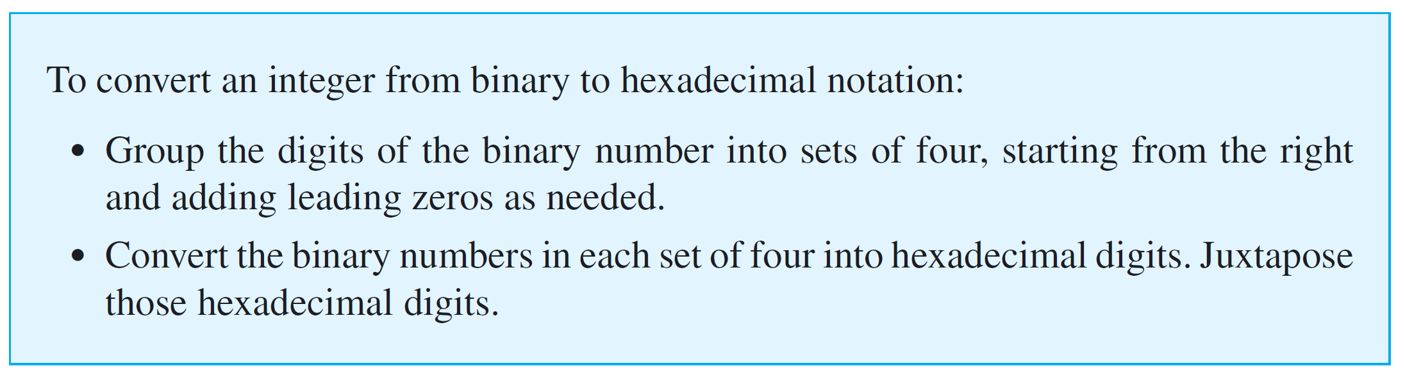
Hexadecimal Notation
To convert integers written in binary notation into hexadecimal notation, reverse the steps of the previous procedure.

Slide 76
Example 13 – Converting from Binary to Hexadecimal Notation
Convert 100110110101001₂ to hexadecimal notation.
Solution:
First group the binary digits in sets of four, working from right to left and adding leading 0’s if necessary.
0100 1101 1010 1001.

Slide 77
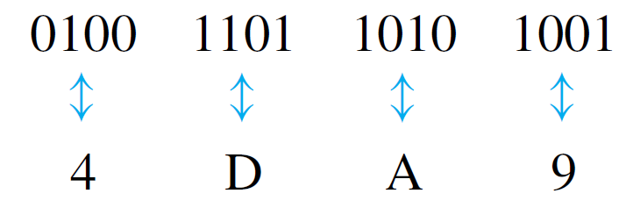
Example 13 – Solution
cont’d
Convert each group of four binary digits into a hexadecimal digit.
Then juxtapose the hexadecimal digits.
4DA9₁₆

